Slide 1
TITLE E-commerce shopping Website NAME agwiscart.com DEVELOPED BY vivek patel Priya patel PRN NO 2016095900000475 2016095900000606

Slide 2
PROJECT PROFILE
Project Title: E-Commerce Shopping website(agwiscart.com)
Project Definition: it’s refers to the buying and selling of goods or services using the internet, and the transfer of money and data to execute these transactions.
Internal Project Guide: Prof. Tulsidas Nakrani
Team Size: 2
Team Members: 1.patel vivek D , 2. patel Priya S
Front End: python 3.8
Using Framework: Django 3.1(python framework)
Back End: mysql
Project Duration: 4 months

Slide 3
EXISTING SYSTEM
Time Consuming
Shipping Rates and Refunds/Returns Disputes
Lack of options
Cash-Back offers not present
Bad customer service
Also there are expenses for traveling from house to shop. More over the shop from where we would like to buy something may not be open 24*7. In order to
overcome these, we have e-commerce solution, i.e. one place where we can get all required goods/products online.

Slide 4
Objective of Developing the new system
The Online Shopping System (OSS) is a web-based application. The purpose of the application is to automate and facilitate the whole process of shopping. This application fixes the limitation and problems of paper based processes. The main goal to increase the quantity of sales by making the new technology of web pages design more attractive and to search a lot of customers and company to their location. By this system we can advertise and send procure to a lot of customer by sending email.
Reduce management costs
Businesses aim at reducing the costs incurred for the betterment of their revenue. Automating the ecommerce business can help in reducing the management cost significantly. Moreover, the right use of digital marketing can help in reducing the cost spent on driving customers to such an extent that businesses can bring customers for free of cost.
Developing business relations
Providing a unique customer experience
Increasing the number of loyal customers
Increasing sales

Slide 5
TIME LINE CHART
Start Project
AUG 10
2020
Jan
Feb
Mar
2020
Apr
May
Jun
Jul
Aug
Sep
Oct
Nov
Dec
WEEK
1 to 4
1 to 4
1 to 4
1 to 4
1 to 4
1 to 4
1 to 4
1 to 4
1 to 4
1 to 4
1 to 4
1 to 4
Definition
AUG 10 - AUG 17
System Analysis
AUG 15 - Aug 29
Database Design
AUG 21 - Sep 15
Page Design
AUG 22 – Oct 25
Coading
AUG 25 - Nov 15
Reports
Nov 15 - Dec 25
Testing
Nov 15 - Dec 25
Documentions

Slide 6
FUNCTIONAL SPECIFICATION
Purpose
This website is used to the buying and selling of goods or services using the internet, and the transfer of money and data to execute these transactions,
Scope
Admin:-
Login
Manage products
Manage cart
Manage orders
View all orders
user:-
Register
Login
Search products
View All products
Add to cart
Make order
Pay bills

Slide 7
General Description
Functional Description
ADMIN:-
View, insert, update, or delete record of admin.
USER:-
View, insert, update, or delete record of any product in cart.
User Characteristics
Admin:-
Admin is a top level person who is responsible for that site management and has keen watch on the site movements. Admin can add Product View all orders and Payment Activity.
User:-
User as well as customer is second level person who can Search and view Products and make order. It can manage cart items

Slide 8
HARDWARE TOOLS
PROCESSOR : Intel Core i3
RAM : 4GB(recommended)
HARD-DISK : 500GB(recommended)
WINDOWS : WINDOWS 10

Slide 9
SOFTWARE TOOLS
FRONT END TOOL : python 3.8
BACK END TOOL : MySQL 5.0
FRAMEWORK : Django 3.1
CODE EDITOR : VS(visual studio) code editor
OTHER TOOLS : MS Word 2016 MS PowerPoint 2016

Slide 10
SYSTEM DESIGN

Slide 11
DATA DICTIONARY
Table name: products
Description: this is products table .it’s a use to showing searching and fetching the products
Primary key: product_id
Foreign key :category_id, subcategory_id
SR.NO | Field Type | Data Type | Size | Constraints | Description
1 | product_id | Int | 11 | Primary key | It’s product id
2 | title | Varchar | 50 | Not null | Product title
3 | price | Int | 11 | Not null | Product price
4 | sell_price | Decimal | 65.2 | NULL | Product sell price
5 | Category_id | int | 11 | Foreign Key | Product category
6 | description | Varchar | 300 | Not null | Product description
7 | slug | Varchar | 50 | NULL | Product slug as tltle
8 | pub_date | date | - | Not null | Product published date
9 | active | Tinyint | 1 | Not null | Check product is available or not
10 | subcategory_id | Int | 11 | Foreign Key | Product sub category

Slide 12
DATA DICTIONARY
Table name: auth_user
Description: this is user as well as customer table .it’s a user authontication table
Primary key: id
Foreign key :
SR.NO | Field Type | Data Type | Size | Constraints | Description
1 | Id | Int | 11 | Primary key | User id
2 | Password | Varchar | 128 | Not null | User password
3 | Last_login | Datetime | 6 | Not null | Last log in date
4 | Is_superuser | Tinyint | 1 | Not null | Check superuser
5 | Username | Varchar | 150 | Unique key | Username use to log in
6 | First_name | Varchar | 30 | Not null | User first name
7 | Last_name | Varchar | 150 | Not null | User last name
8 | email | Varchar | 254 | Not null | User e-mail address
9 | Is_staff | Tinyint | 1 | Not null | Chack the user is staff
10 | Is_active | Tinyint | 1 | Not null | Check user is active
11 | Date_joined | Datetime | 6 | Not null | User added time

Slide 13
DATA DICTIONARY
Table name: Category
Description: this is Category table .it’s a use to Categorised the products
Primary key: category_id
Foreign key :
SR.NO | Field Type | Data Type | Size | Constraints | Description
1 | category_id | int(11) | 11 | Primary key | Category id
2 | title | varchar(128) | 128 | Not null | Category title
3 | description | varchar(300) | 300 | Not null | Category description
4 | slug | varchar(50) | 50 | NULL | Category slug
5 | thumbnail | tinyint(1) | 1 | Not null | Check thumbnail
6 | active | tinyint(1) | 1 | Not null | Check Category active
7 | timestamp | datetime(6) | 6 | Not null | Category added time

Slide 14
DATA DICTIONARY
Table name: SubCategory
Description: this is SubCategory table .it’s a use to define subcategory of the products
Primary key: category_id
Foreign key :
SR.NO | Field Type | Data Type | Size | Constraints | Description
1 | subcategory_id | int(11) | 11 | Primary key | SubCategory id
2 | title | varchar(128) | 128 | Not null | SubCategory title
3 | description | varchar(300) | 300 | Not null | SubCategory description
4 | slug | varchar(50) | 50 | NULL | SubCategory slug
5 | thumbnail | tinyint(1) | 1 | Not null | Check thumbnail
6 | active | tinyint(1) | 1 | Not null | Check SubCategory active
7 | timestamp | datetime(6) | 6 | Not null | SubCategory added time

Slide 15
DATA DICTIONARY
Table name: UserCart
Description: this is user as well as customer table .it’s a user authontication table
Primary key: id
Foreign key :cart_id,product_id
SR.NO | Field Type | Data Type | Size | Constraints | Description
1 | id | Int | 11 | Primary key | Cart items id
2 | quantity | Int | 11 | Not null | Product quantity
3 | Payment_status | Tinyint | 1 | Not null | Totle products price
4 | added_on | Datetime | 6 | Not null | Product Added time
5 | updated | Datetime | 6 | Not null | Cart updated time
6 | owner_id | Int | 11 | Foreign Key | Which user cart
7 | product_id | Int | 11 | Foreign Key | Product id

Slide 16
DATA DICTIONARY
Table name: productsImages
Description: this is product images table .it’s a use to store the products images
Primary key: id
Foreign key :product_id
SR.NO | Field Type | Data Type | Size | Constraints | Description
1 | id | Int | 11 | Primary key | ProductsImages Id
2 | image | Varchar | 100 | Not null | Product Images url
3 | featured | Tinyint | 1 | Not null | Product fratured
4 | active | Tinyint | 1 | Not null | Check the Product is active
5 | timestamp | Datetime | 6 | Not null | Product Added time
6 | product_id | Int | 11 | Foreign Key | Product id

Slide 17
DATA DICTIONARY
Table name: contact
Description: this is contact us table .it’s a use to store the contact us details
Primary key: cid
Foreign key :
SR.NO | Field Type | Data Type | Size | Constraints | Description
1 | cid | Int | 11 | Primary key | Contact id
2 | fullname | Varchar | 255 | Not null | User full name
3 | subject | Varchar | 50 | Not null | Subject detail
4 | cemail | Varchar | 10 | Not null | User email
5 | msg | Longtext | - | Not null | Message
6 | timestamp | Datetime | 6 | Not null | Added time

Slide 18
DATA DICTIONARY
Table name: order
Description: this is order table .it’s a use to store order information
Primary key: id
Foreign key :
SR.NO | Field Type | Data Type | Size | Constraints | Description
1 | Order_id | Int | 11 | Primary key | Cart id
2 | first_name | Varchar | 90 | Not null | Order Owner first name
3 | last_name | Varchar | 90 | Not null | Order Owner last name
4 | state | Varchar | 111 | Not null | Order Owner state
5 | address | Varchar | 111 | Not null | Order Owner address
6 | address2 | Varchar | 111 | Null | Order Owner address 2
7 | City | Varchar | 111 | Not null | Order Owner city
8 | Zip_code | Varchar | 111 | Not null | Order Owner zip_code
9 | Phone | Varchar | 111 | Not null | Order Owner contact number
10 | email | Varchar | 111 | Not null | Order Owner email
11 | amount | int | 10 | Not null | Totle order amount

Slide 19
E-R DIAGRAM
Category_id
has
m
Categorys
Paymentstatus
price
owner_id
title
id
title
quntity
Product_id
m
products
m
Add in
1
User Cart
Product_id
category
m
m
m
Subcategory_id
Search & view
1
Confirm
has
SubCategorys
password
title
Order_id
amount
usernme
address
1
m
m
Auth_user
1
has
m
orders
id

Slide 20
UML DIAGRAM

Slide 21
USE CASE DIAGRAM
ADMIN:-
LOG IN
ADD PRODUCT
REMOVE PRODUCT
VIEW PRODUCT
ADMIN
MANAGE ORDERS
ADD USERS
E-COMMERCE SYSTEM
(AGWISCART.COM)

Slide 22
USE CASE DIAGRAM
USERS(CUSTOMERS):-
SIGN UP
LOG IN
SEARCH PRODUCT
VIEW PRODUCT
ADD PRODUCT IN CART
USERS
MAKE ORDER
TRACK ORDER
E-COMMERCE SYSTEM
(AGWISCART.COM)

Slide 23
CLASS DIAGRAM
category
order
Category_id(p.k)
Title
Order_id(p.k)
amount
subcategory
SubCategory_id(p.k)
Title
+add()
-edit()
-del()
+upd()
+add()
-edit()
-del()
+upd()
0…*
+add()
-edit()
-del()
+upd()
0…*
user
products
id(p.k)
Username(u.k)
password
0…*
Product_id(p.k)
Category_id(f.k)
Subcategory_id(f.k)
+add()
-edit()
-del()
+upd()
User Cart
+add()
-edit()
-del()
+upd()
id(p.k)
cart_id(f.k)
product_id(f.k)
…0
0…*
+add()
-edit()
-del()
+upd()
0…*

Slide 24
SEQUENCE DIAGRAM :- ADMIN
ADMIN
SYSTEM
DATABASE
1.0 Log In
1.1 Request For Log In
1.3 Successfully Log In
1.2 Response For Log In
2.0 Add/remove products
2.1 Request For Add/remove products
2.3 Successfully Add/remove products
2.2 Response For Add/remove Products
3.0 Add User
3.1 Request For Add User
3.3 Successfully User Added
3.2 Response For Add User
4.0 manage Cart
4.1 Request For manage Cart
4.3 Successfully manage Cart
4.2 Response For manage Cart
5.0 manage orders
5.1 Request For manage orders
5.3 Successfully manage orders
5.2 Response For manage orders
6.0 Log out
6.3 Successfully Log out

Slide 25
SEQUENCE DIAGRAM :- USER
USER
SYSTEM
DATABASE
1.0 sign up or Log In
1.1 Request For sign up or Log In
1.3 Successfully sign up or Log In
1.2 Response For sign up or Log In
2.0 View & search products
2.1 Request For View & search products
2.3 Successfully View & search products
2.2 Response For View & search products
3.0 Add to cart products
3.1 Request For Add to cart products
3.3 Successfully Add to cart products
3.2 Response For Add to cart products
4.0 make orders
4.1 Request For make orders
4.3 Successfully make orders
4.2 Response For make orders
5.0 Pay bills
5.1 Request For Pay bills
5.3 Successfully Pay bills
5.2 Response For Pay bills
6.0 Log out
6.3 Successfully Log out

Slide 26
ACTIVITY DIAGRAM :- ADMIN
Log In
Is Valid
No
Yes
Add Products
View & Manage Cart Items
View & Manage orders
View & Manage Users
Remove Products
Add User
View Payments info
Log out

Slide 27
ACTIVITY DIAGRAM :- User
Sign up
Log In
Is Valid
No
Yes
View Products
Manage Cart Items
Search Products
Track order
Add To Cart Products
Make Order
Pay bills
Log out

Slide 28
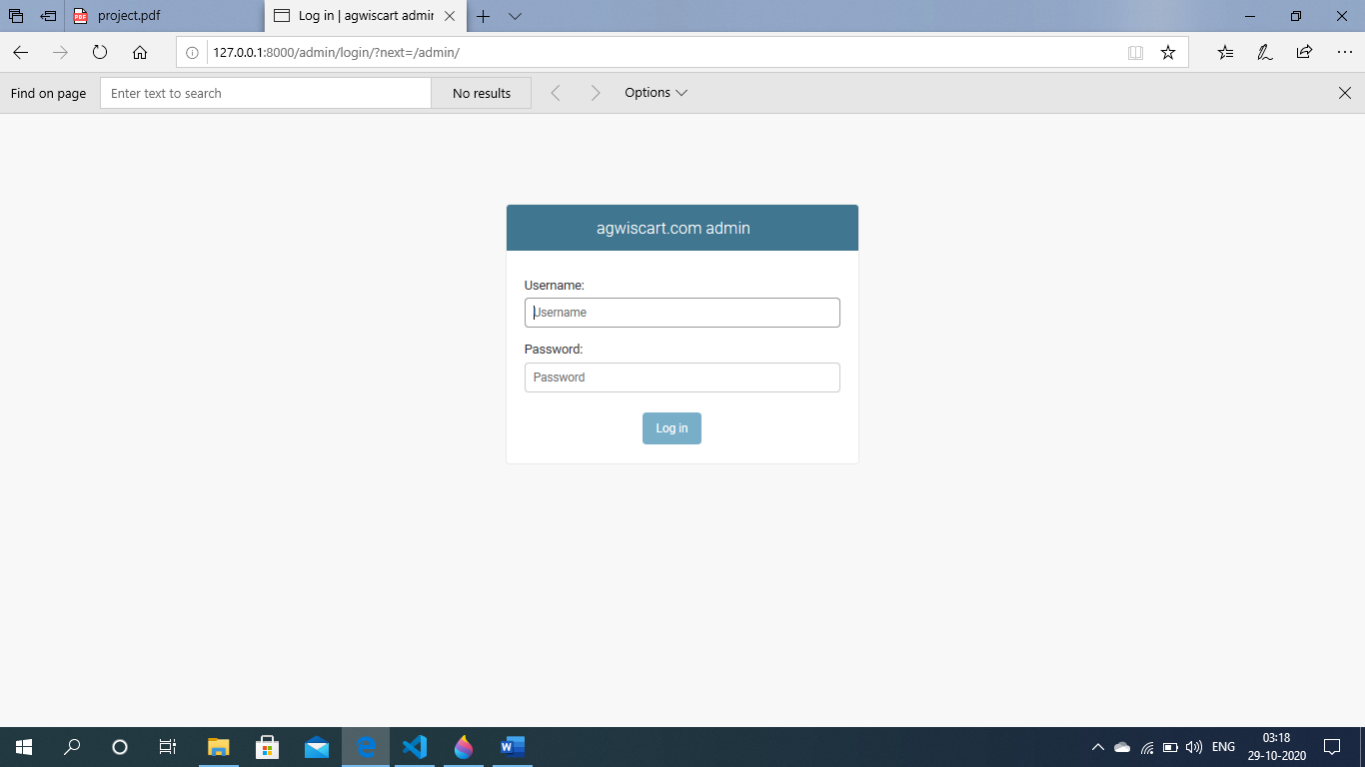
Input & Output Designing
Admin Side Design
Login page:- this page is admin login page

Slide 29
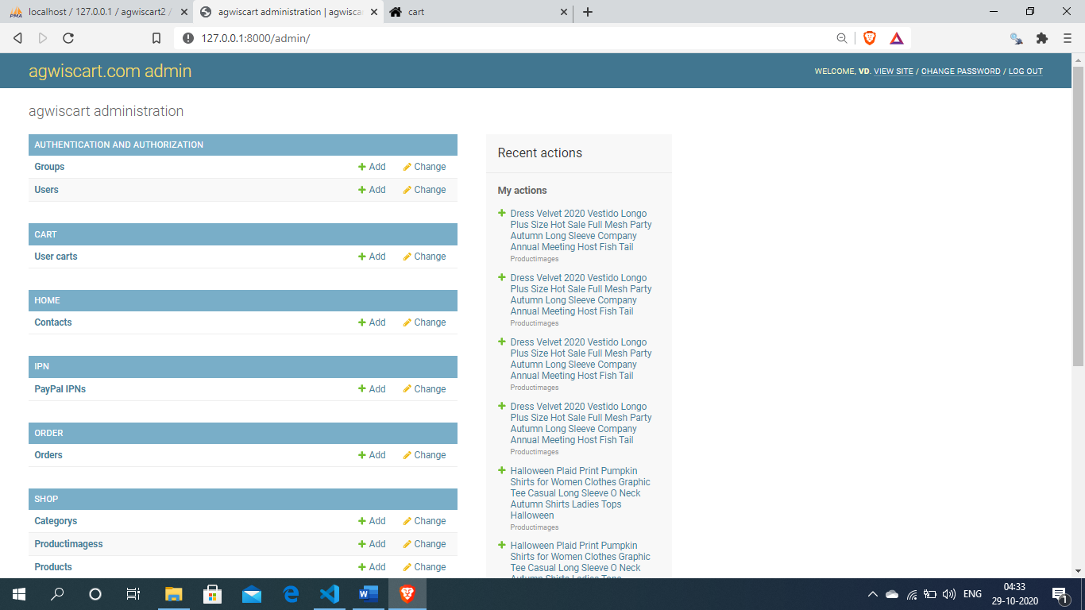
Input & Output Designing
Admin home page:-

Slide 30
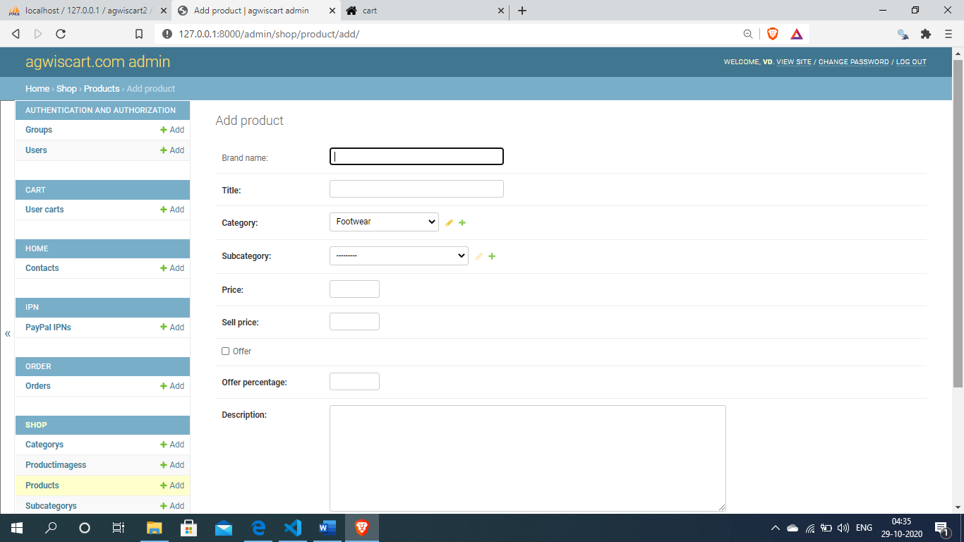
Input & Output Designing
Admin add products :-

Slide 31
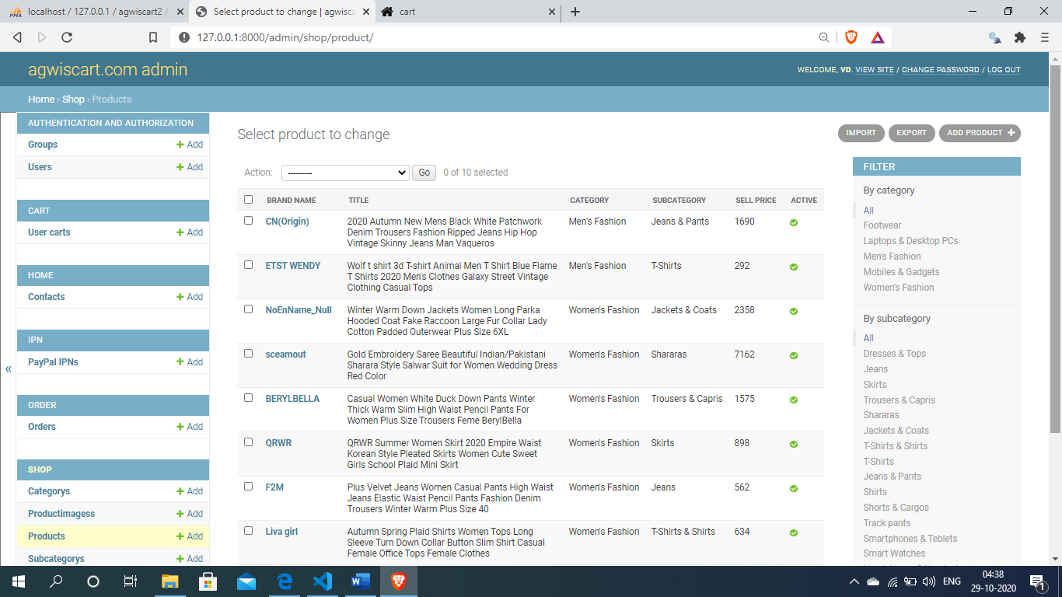
Input & Output Designing
View products :-

Slide 32
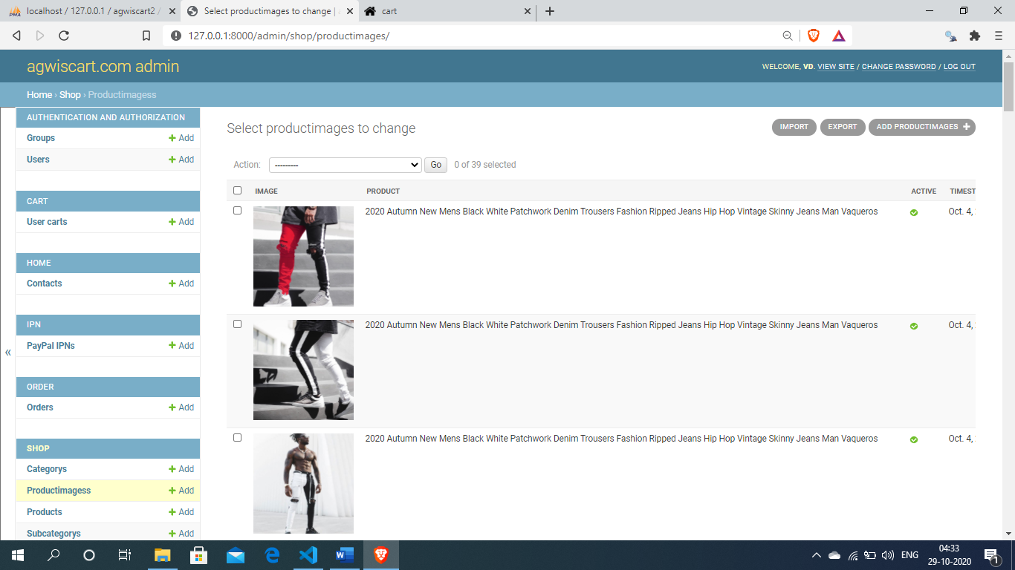
Input & Output Designing
View product images :-

Slide 33
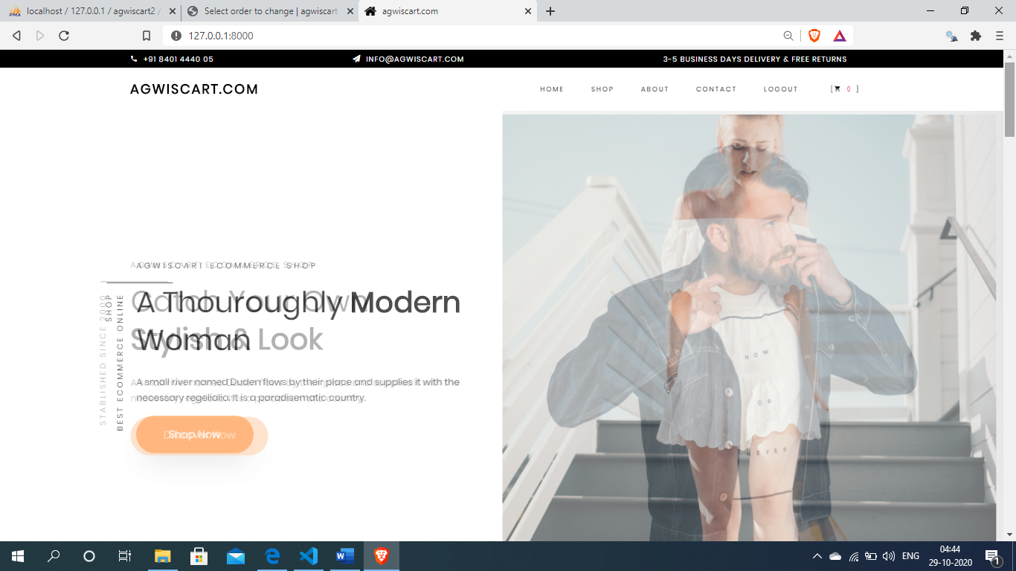
Input & Output Designing
User side design
User home page:-this page is agwiscart.com home page

Slide 34
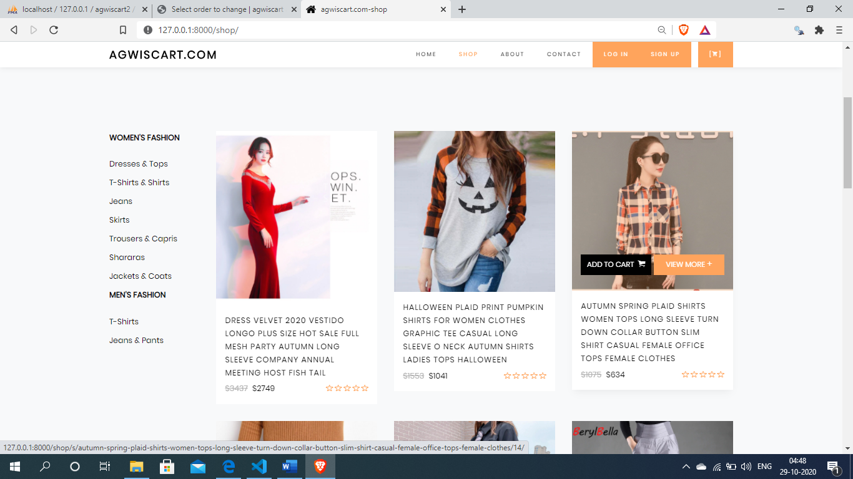
Input & Output Designing
Shop page

Slide 35
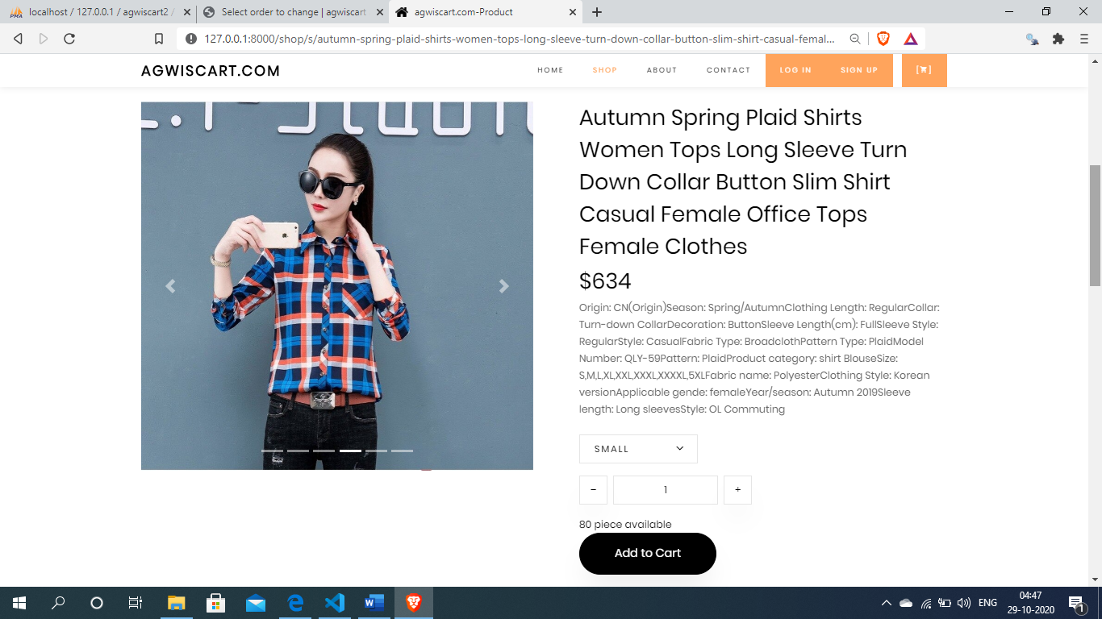
Input & Output Designing
Shop page

Slide 36
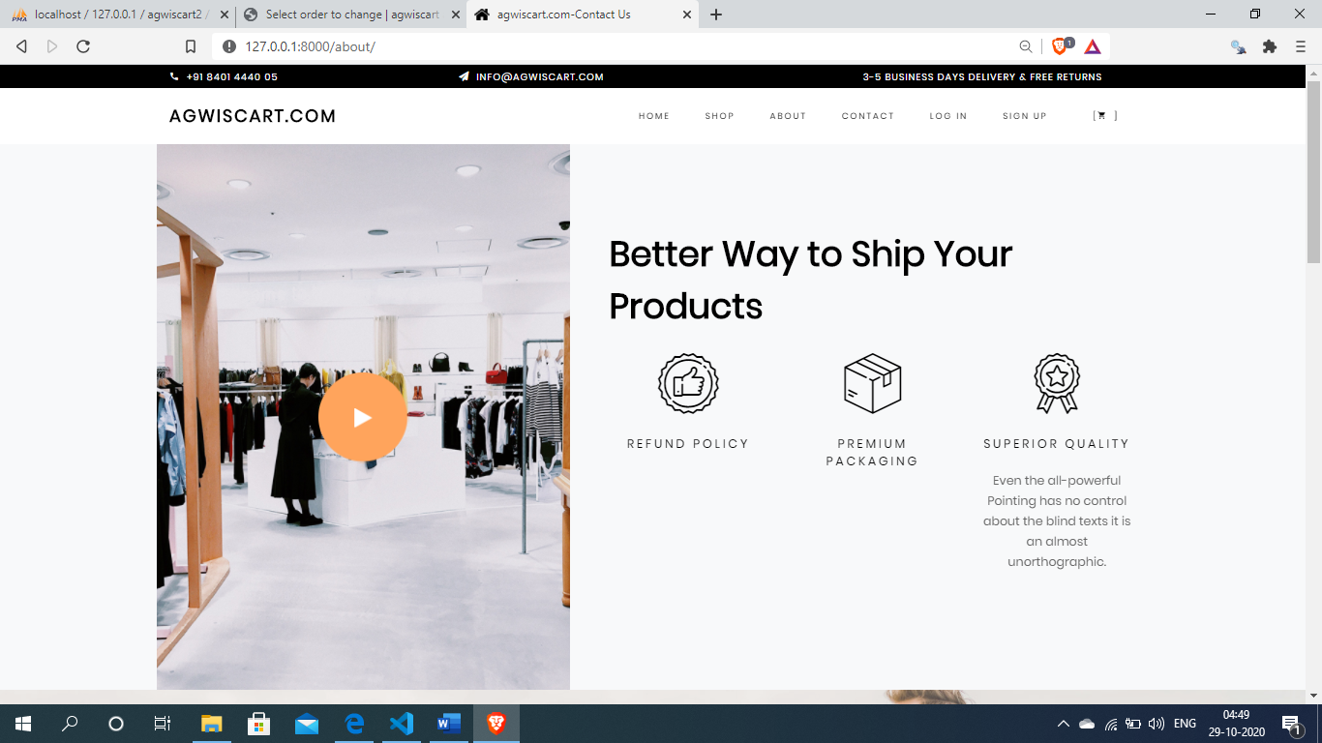
Input & Output Designing
About page

Slide 37
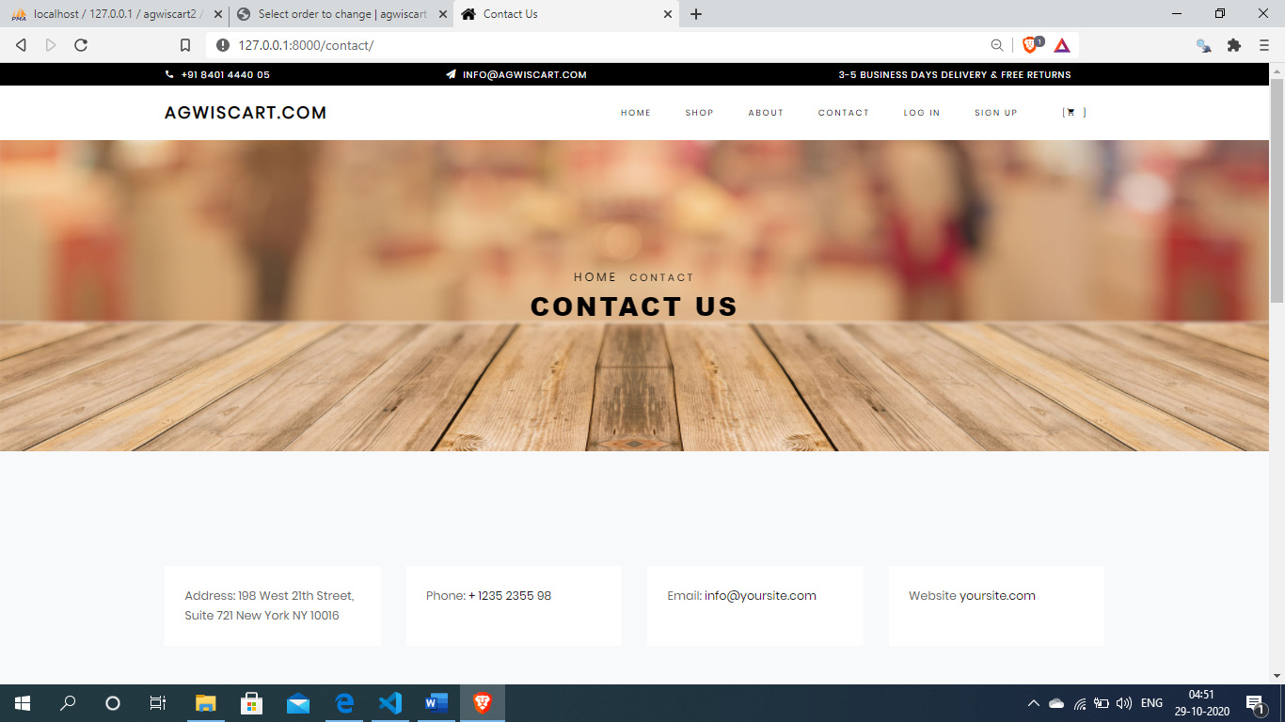
Input & Output Designing
Contact page

Slide 38
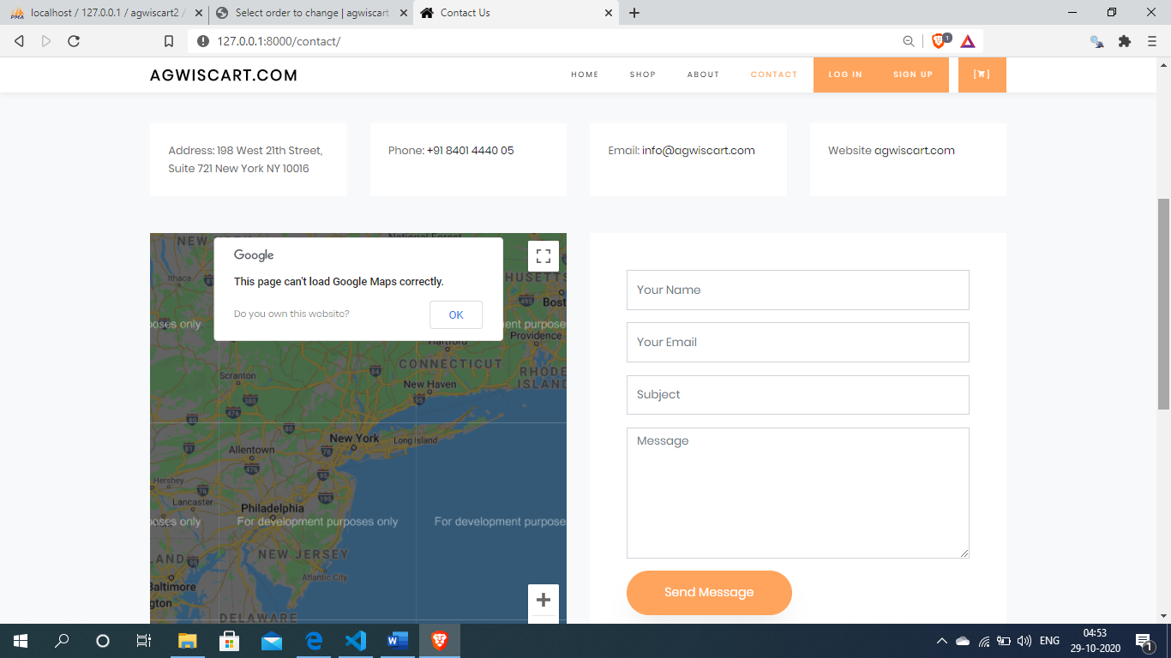
Input & Output Designing
Contact page

Slide 39
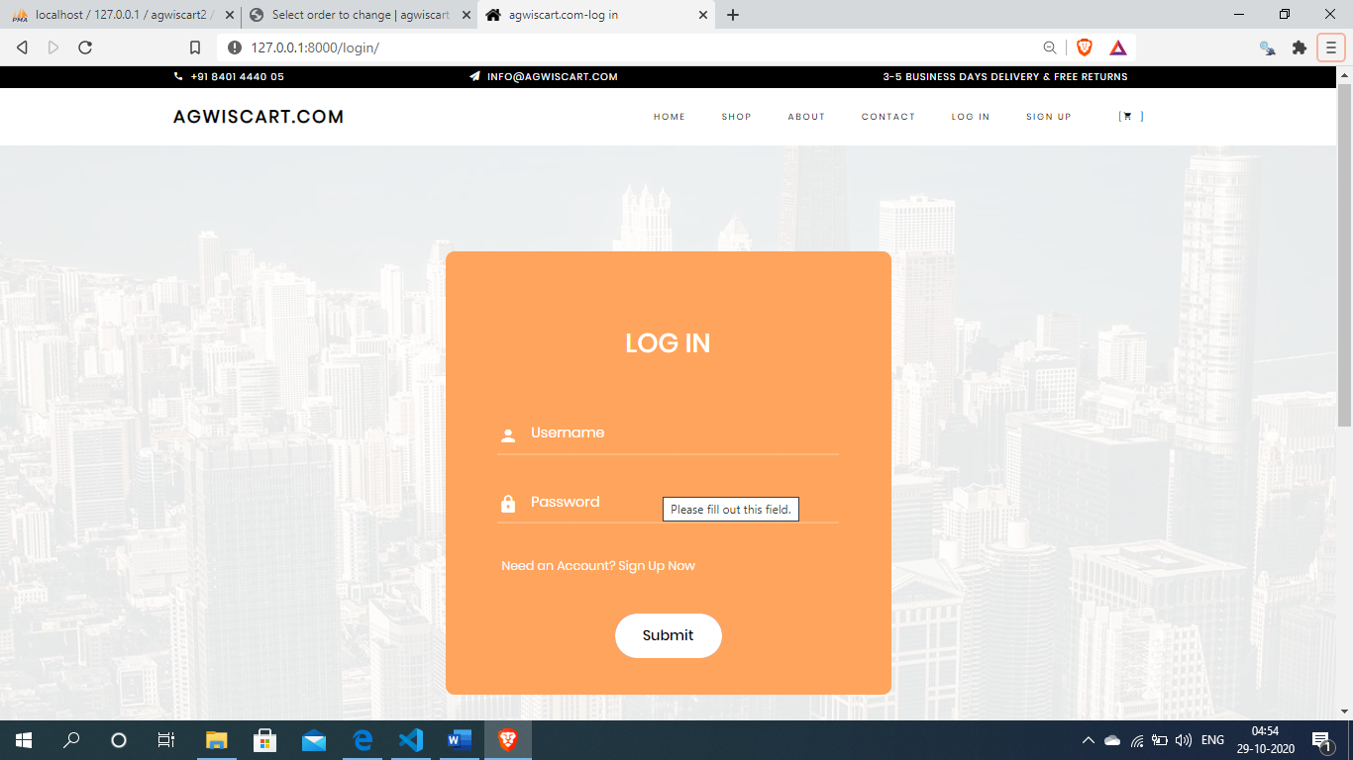
Input & Output Designing
User log in page

Slide 40
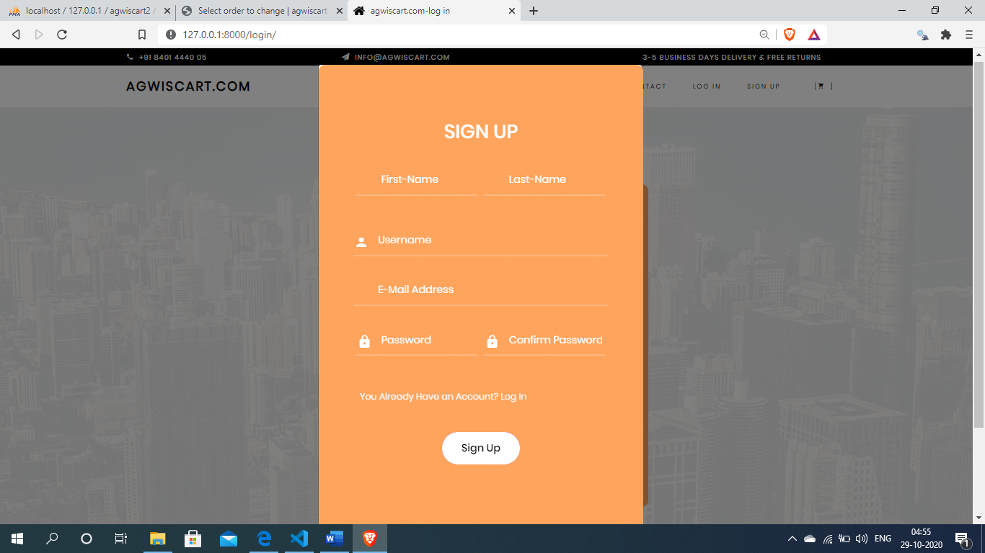
Input & Output Designing
User sign up page

Slide 41
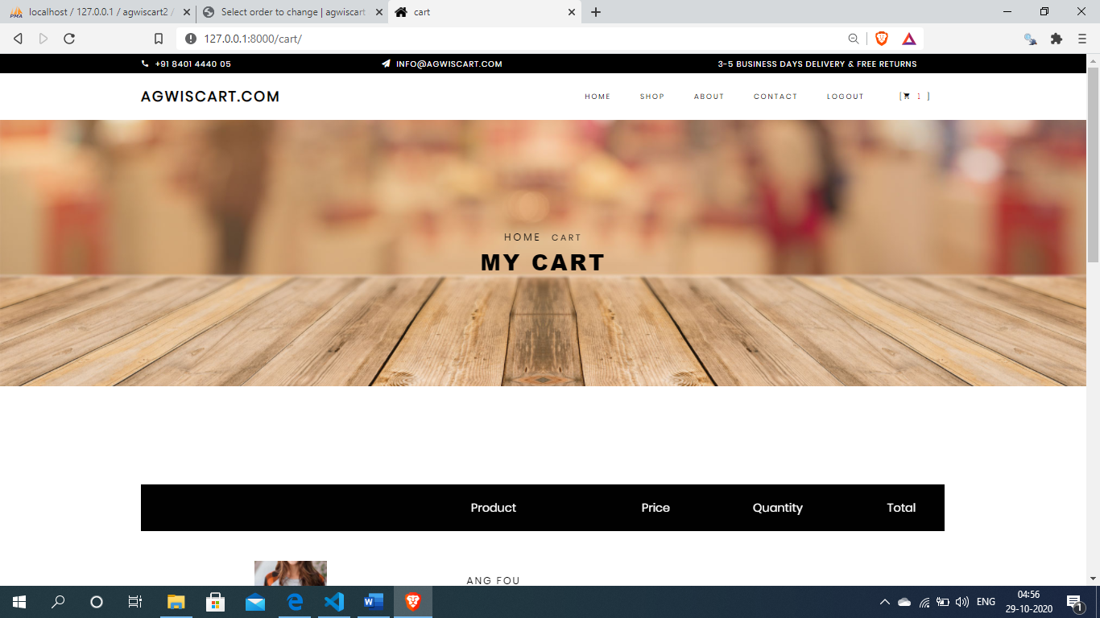
Input & Output Designing
Shopping cart page

Slide 42
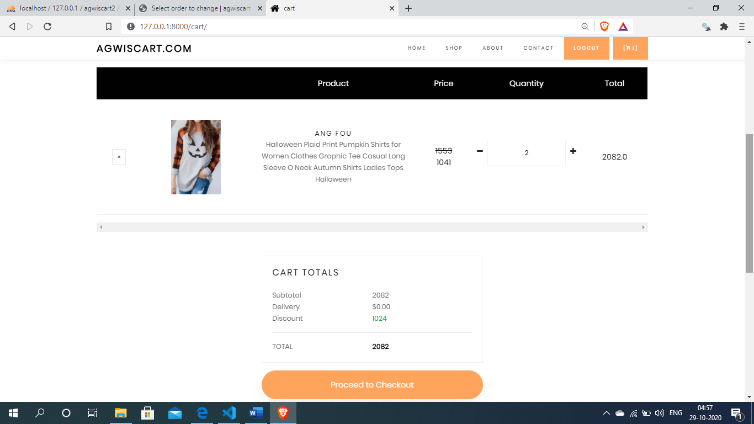
Input & Output Designing
Shopping cart page

Slide 43
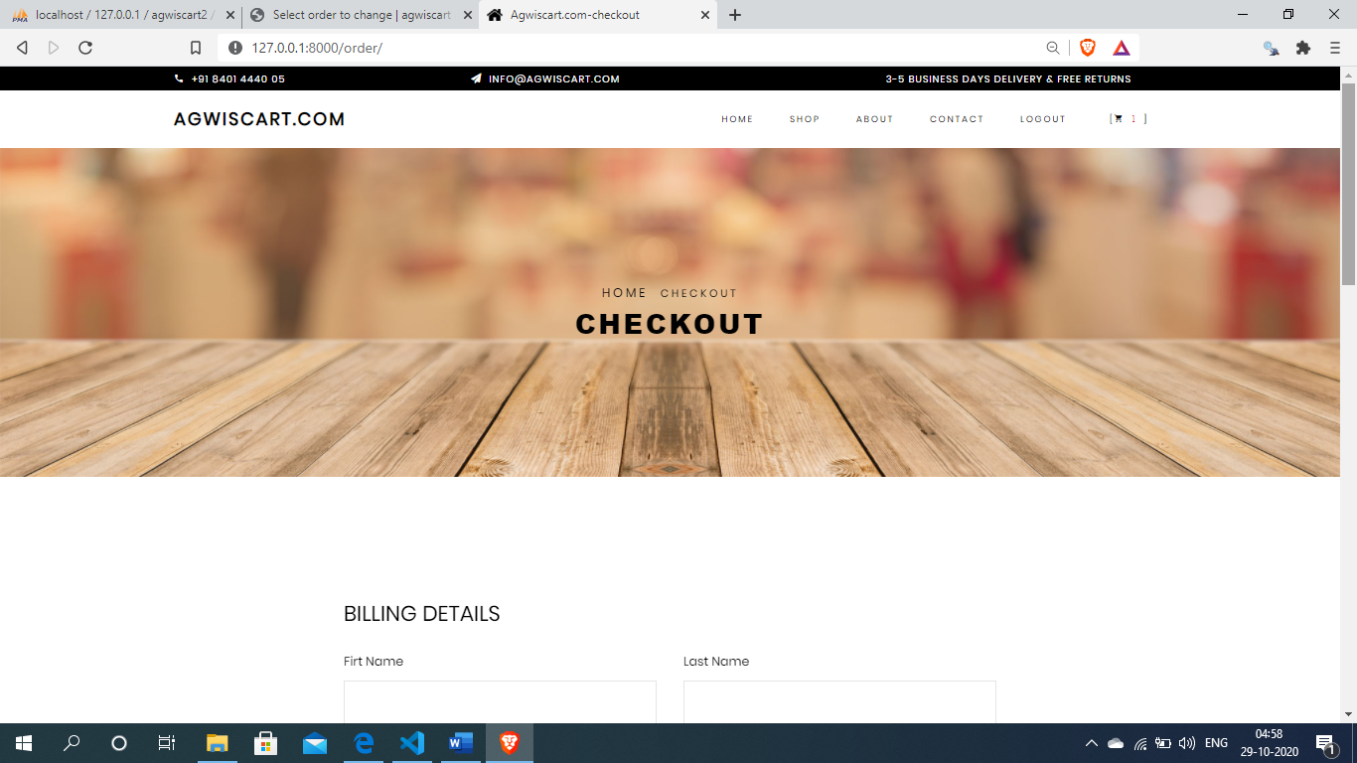
Input & Output Designing
User checkout page

Slide 44
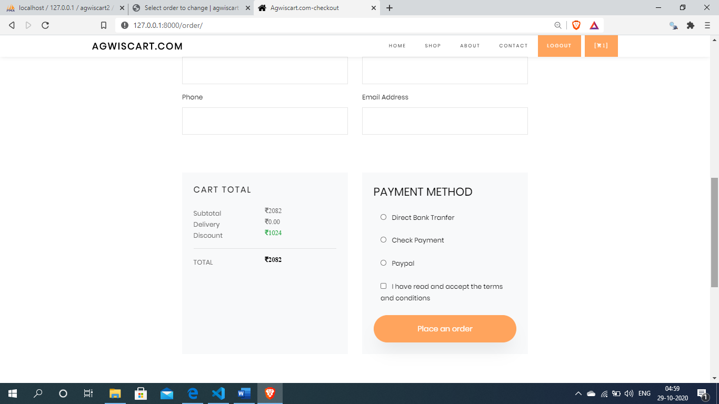
Input & Output Designing
User checkout page

Slide 45
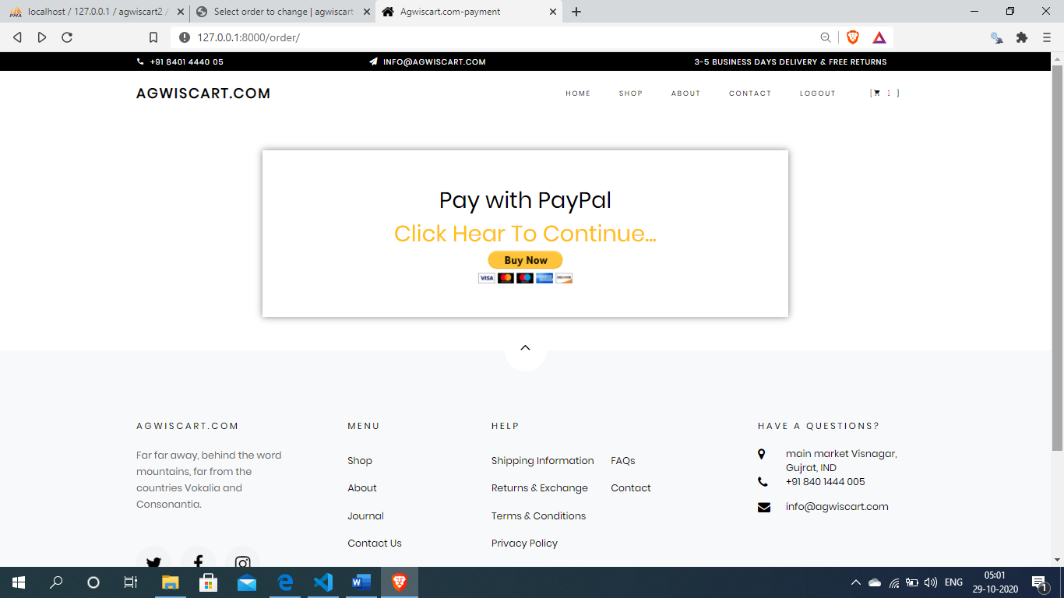
Input & Output Designing
Payments page

Slide 46
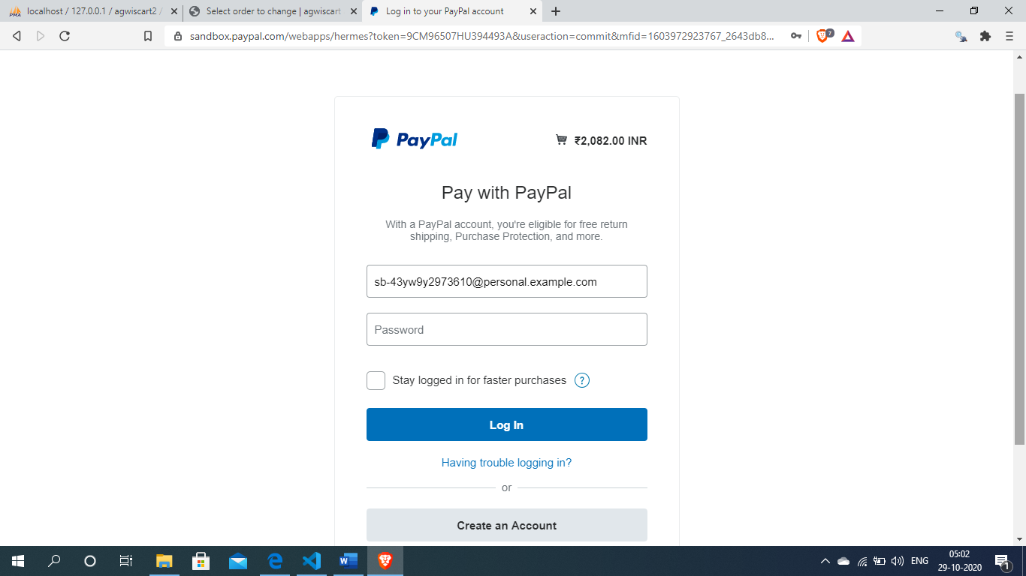
Input & Output Designing
After click the buy now button open payments gateway(paypal)
For pay the bills

Slide 47
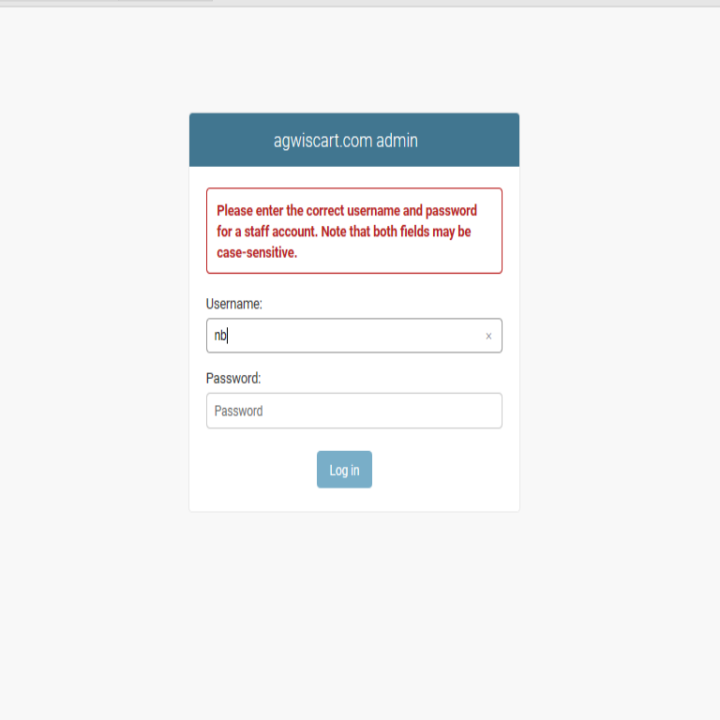
Test Cases
Admin Login Form :-
SI NO. | Test case | Expected Result | Test Result
1 | Enter valid name and password & click on login button | Display main window | Success
2 | Enter invalid name and password & click on login button | Does not display main window and show the error | Success

Slide 48
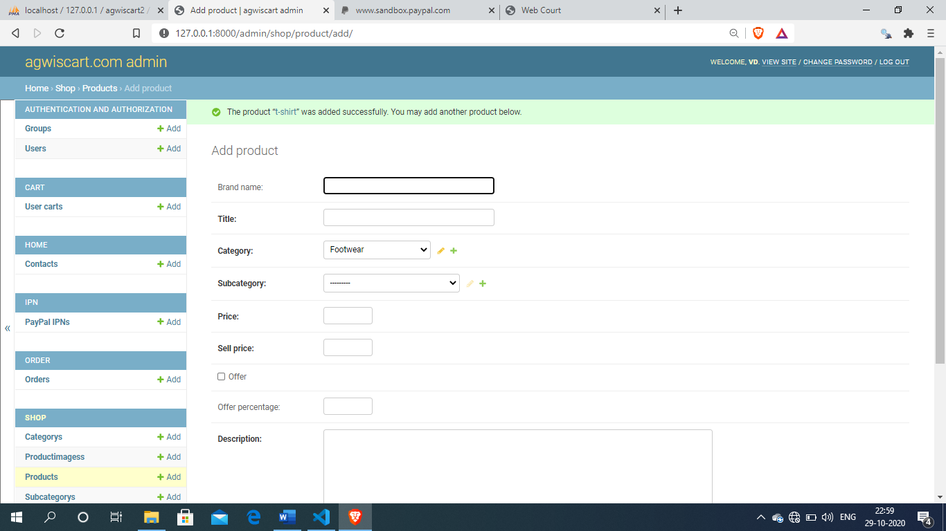
Test Cases
Admin add products Form :-
SI NO. | Test case | Expected Result | Test Result
1. | On the click of ADD PRODUCT button | At first user have to fill all fields with proper data , if any Error like entering text data instead of number or entering number instead of text..is found then it gives proper message otherwise Adds Record To the Database | Success

Slide 49
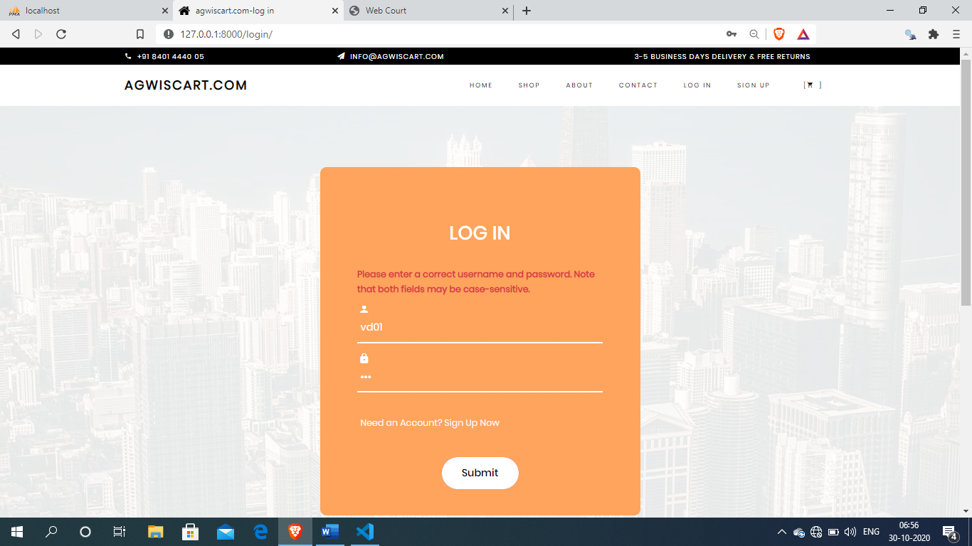
Test Cases
User login form :-
SI NO. | Test case | Expected Result | Test Result
1 | Enter valid name and password & click on login button | User can add products in cart and create own cart. User can checkout and pay bills and make orders | Success
2 | Enter invalid name and password & click on login button | User does not can add products in cart and does not create own cart. User does not can checkout and pay bills and does not make orders | Success

Slide 50
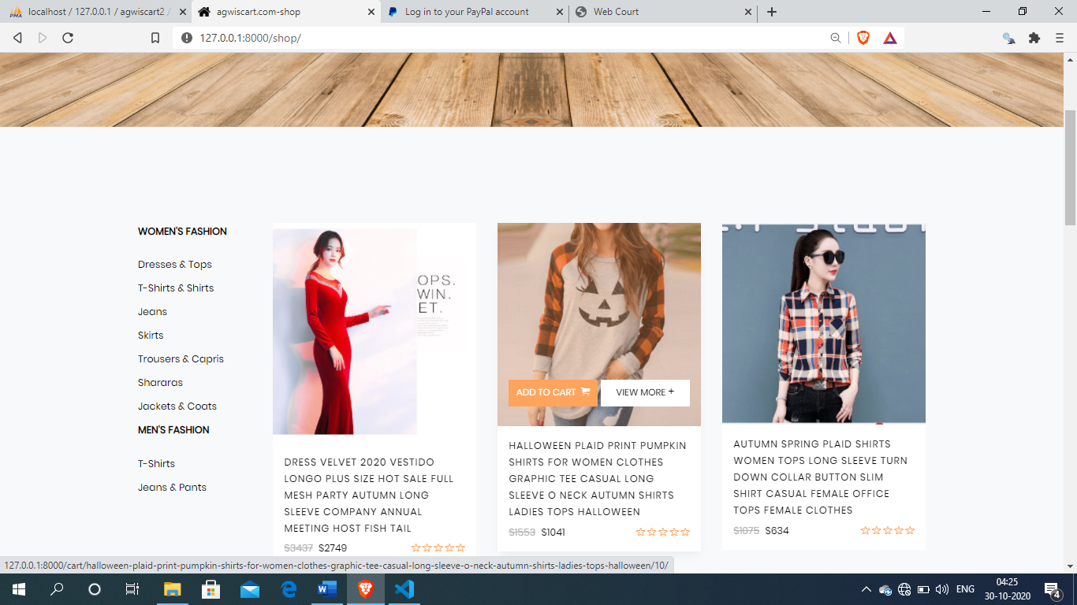
Test Cases
User add product in cart :-
SI NO. | Test case | Expected Result | Test Result
1. | On the click of ADD TO CART button | Add product in cart | Success

Slide 51
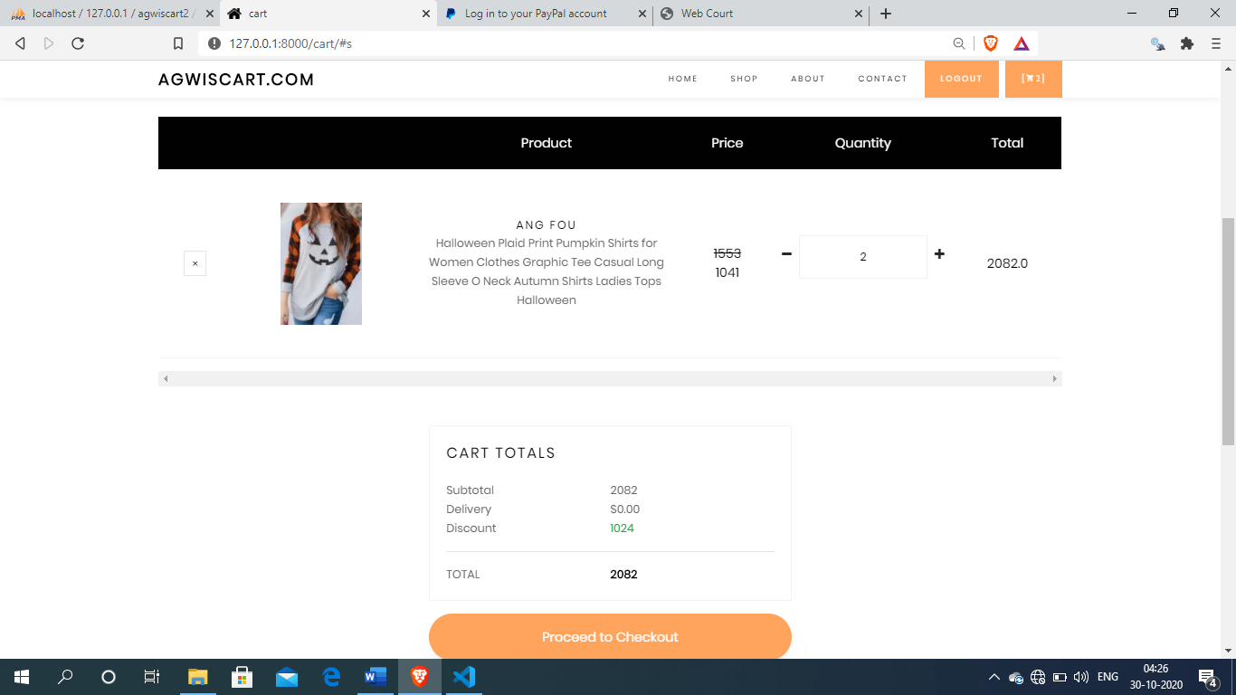
Test Cases
User manage products quantity in cart:-
SI NO. | Test case | Expected Result | Test Result
1. | On the click PLUS(+) button | Add product quantity in cart also added from database . and manage the total price of cart items | Success
2 | On the click MINUS(-) button | Minus product quantity and if quantity is 0 than product automatically remove from cart . and manage the total price of cart items | Success
3 | On the click remove button | Remove product from cart | Success

Slide 52
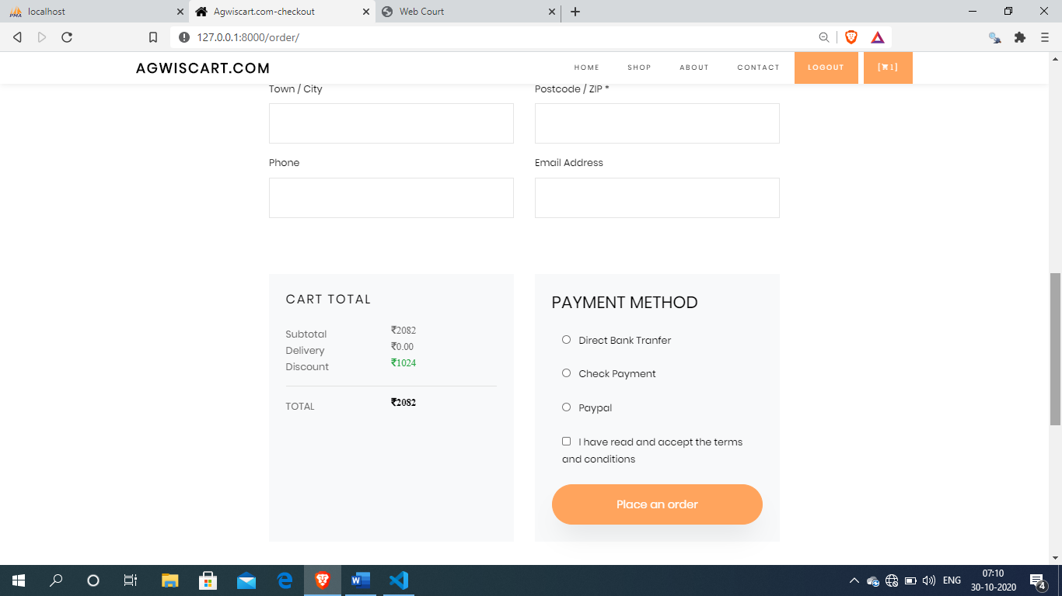
Test Cases
User make order:-
SI NO. | Test case | Expected Result | Test Result
1. | On the click place an order button | At first user have to fill all fields with proper data , if any Error like entering text data instead of number or entering number instead of text..is found then it gives proper message otherwise Adds Record To the Database,pay bills and make order | Success

Slide 53
LIMITATIONS & FUTURE SCOPE
Limitations
Limitation of this web site is available in only India.
Future Scope
In the future can SMS & Email order details Facility can be implemented in this system.

Slide 54
CONCLUSION
The conclusion is that
The shop owner can easily maintain the system as well as customer and order information.
have the choice to shop online or make purchases in the traditional manner.
Online shopping has increased and changed the way people shop.
There is convince having the ability to shop from home. *With the introduction of internet shopping online has become popular. Shopping online allows access to merchandise sold world wide. It is a growing part of retail. Online shopping is time saving and convenient. There is often no cost for traveling when ordering items online.

Slide 55
REFERENCES
Web Sites References
http://www.youtube.com
http://www.javapoint.com
https://docs.djangoproject.com/en/3.1/
https://docs.python.org/3/
https://pypi.org/
https://getbootstrap.com/
https://stackoverflow.com/

Slide 56


